Slide 1
Sorting Algorithms
Instructor: Javeria Naz

Slide 2
Selection Sort
The selection sort algorithm sorts an array by repeatedly finding the minimum element (considering ascending order) from unsorted part and putting it at the beginning.
The algorithm maintains two subarrays in a given array. 1) The subarray which is already sorted. 2) Remaining subarray which is unsorted.
In every iteration of selection sort, the minimum element (considering ascending order) from the unsorted subarray is picked and moved to the sorted subarray.

Slide 3
Selection Sort
Selection sort is the simplest sorting method.
It first finds the smallest value in the array and exchanges this value with the value in the first position of the array.
Then, it finds the second smallest value and exchanges this value with the value in the second position of the array and so on.
This process continues until the entire array is sorted.
Selection sort method is relatively easy to implement.
It is also slightly faster than bubble sort because selection sort makes only one exchange for every pass through the list or array.
It is, however, inefficient for larger lists.
To sort an array of "n" elenients, n-1 passes (or iterations) are required.

Slide 4
Cont.
The following steps explain sorting of data in an array in ascending order using selection sort method:
In first pass or iteration, the whole array is searched to find the smallest value. The element of the array that has the smallest value is selected. This value is exchanged (interchanged) with the first element of the array in order to place the smallest value at the first position.
In second pass, the array is searched from second element to the last element of the array to find the smallest value (i.e. second smallest value). This value is exchanged with the second element of the array and so on.
This process is repeated until last element is sorted.

Slide 5
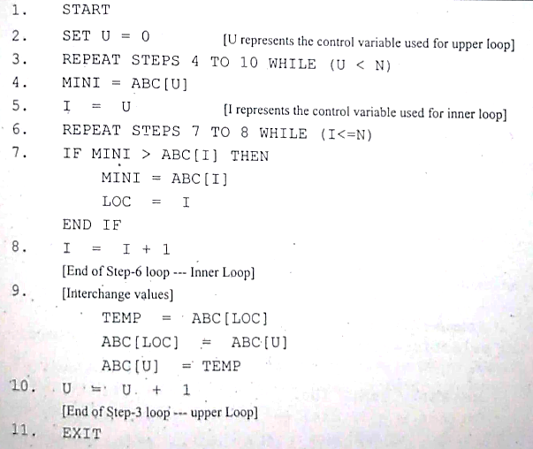
Algorithm

Slide 6
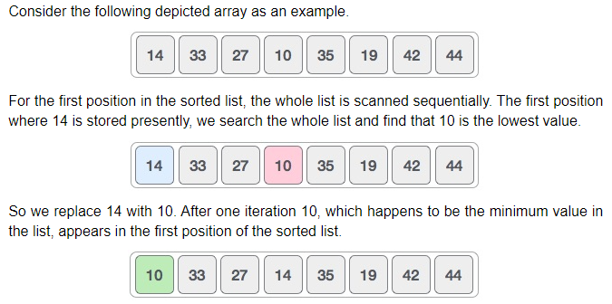
Example

Slide 7
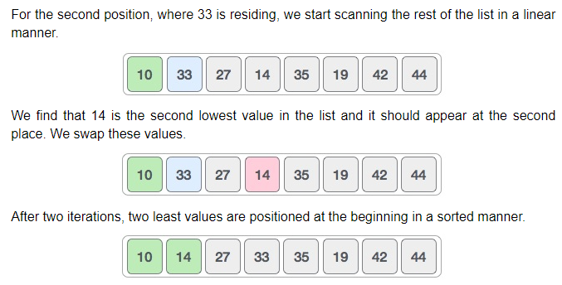
Cont.

Slide 8
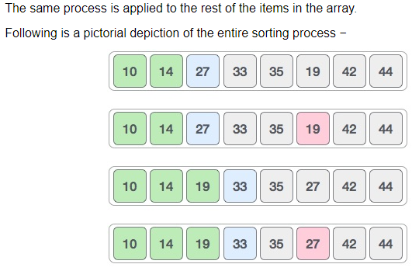
Cont.

Slide 9
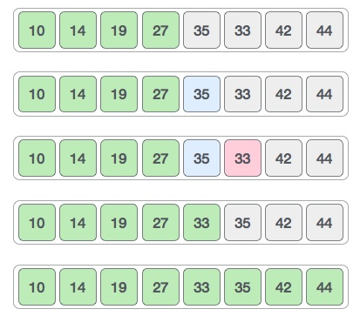
Cont.

Slide 10
Quick Sort
Like Merge Sort, Quick Sort is a Divide and Conquer algorithm.
It picks an element as pivot and partitions the given array around the picked pivot.
There are many different versions of quickSort that pick pivot in different ways.
Always pick first element as pivot.
Always pick last element as pivot
Pick a random element as pivot.
Pick median as pivot.

Slide 11
Cont.
The key process in quickSort is partition().
Target of partitions is, given an array and an element x of array as pivot, put x at its correct position in sorted array and put all smaller elements (smaller than x) before x, and put all greater elements (greater than x) after x.
All this should be done in linear time.

Slide 12
Cont.
The array is reordered or rearranged.
All the values smaller than pivot are moved to the left side of pivot element and all the values greater than the pivot are moved to the right side of pivot
element (with values equal to the pivot. going either side).
The array is logically divided into two sub-arrays.
In this step, data stored in an array is read (or examined) from left side and then right side at a time and then moved to the proper sides of pivot element.
In this process, two pointers work together, namely L (for left marker) and R (for right marker).
At the beginning of partition, L points to the first element of the array and R points to the last
element of the array. pointer L moves forward, while the pointer R moves backward.

Slide 13
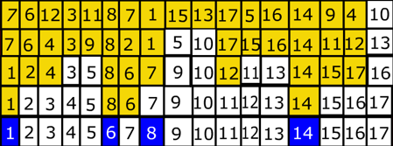
Example Quick Sort

Slide 15


Slide 16


Slide 17


Slide 18


Slide 19
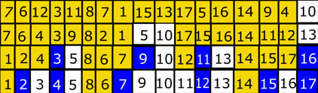

Slide 20
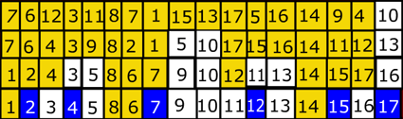

Slide 21
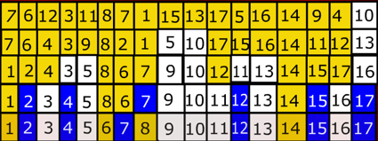

Slide 22
